Slide 1


CONGRATULATIONS
May 2017 Graduating Seniors
Division of Business Services

Slide 2
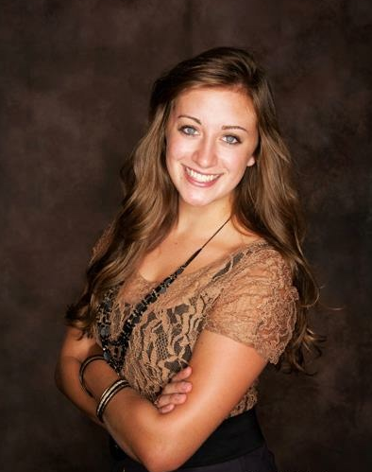
Kimberly Correll
Degree: Bachelor of Business Administration
Major: Finance, Investment & Banking
Worked in: Travel and Cards, Accounting
After graduation I will be heading to Minneapolis to work as an M&A-focused financial analyst for an investment bank called TripleTree. While excited for a new adventure, I am going to miss the wonderful people that I got to work with the past few years in Accounting Services. Through this job, I learned the importance of organization, balance, and challenging yourself to learn more. Thank you all for the opportunity to work here, and for the skills that will help me accomplish my career endeavors.

Slide 3
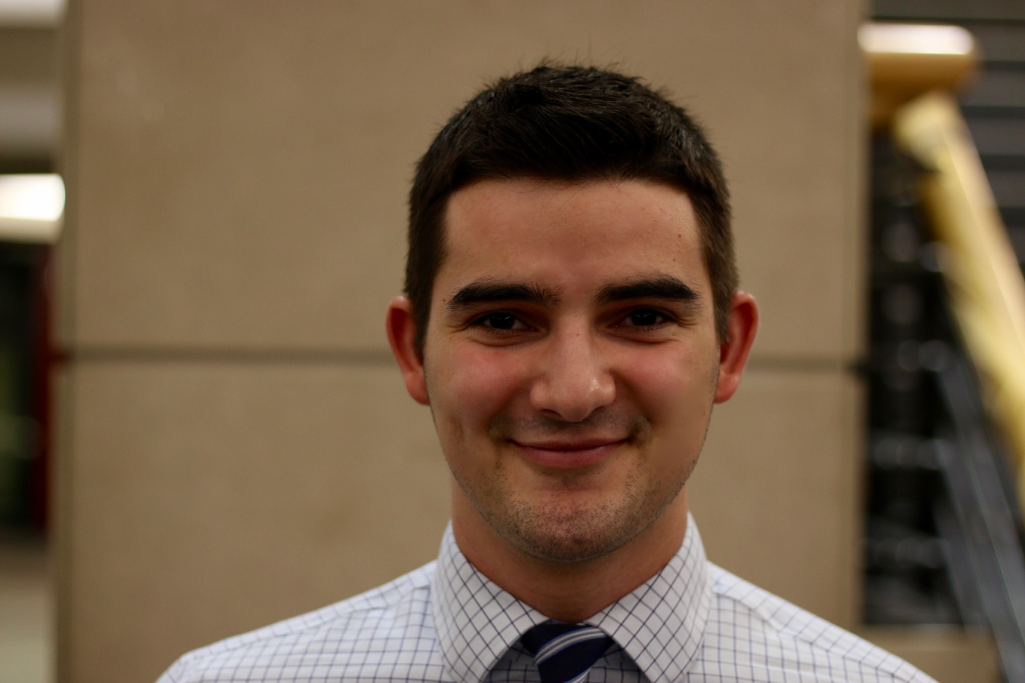
Eddie Hettel
Degree: Bachelor of Business Administration
Major: Management and Human Resources
Worked in: Bursar’s Office
Upon graduation, I will be starting a full-time position with the Milwaukee Tool Corporation in Chicago, IL, and later plan to attend law school. Throughout my time at the Bursar’s Office, I have gained invaluable knowledge on customer service, software such as CashNet and Oracle, and the ways in which the U.S. education system operates. The biggest enjoyment of the position, however, was my coworkers. Even though most of them were Packer fans, supervisors and student employees were all extremely knowledgeable, helpful, and fun to be around.

Slide 4
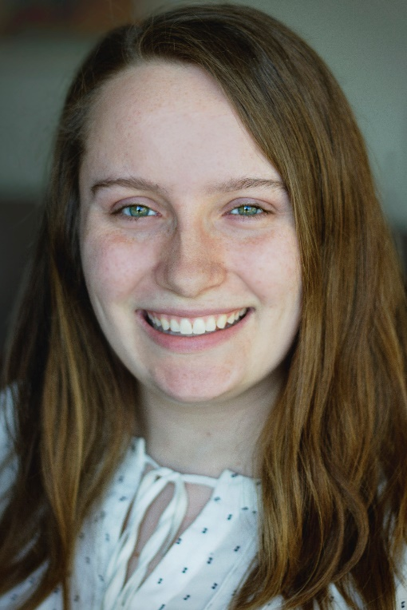
Sarah Lesar
Degree: Bachelor of Business Administration
Major: Operations and Technology Management, Supply Chain
Worked in: Travel and Cards, Accounting
After graduation, I will be doing a six-month internship with Lands’ End in their distribution center operations and supply chain. I learned so much from working at Accounting Services, but I think my favorite thing was just seeing how truly far our university’s impact goes – across the globe and over many disciplines of study, research, work, and play. It was fun to be a part of that, and even better to work alongside my wonderful supervisors and fellow interns.

Slide 5
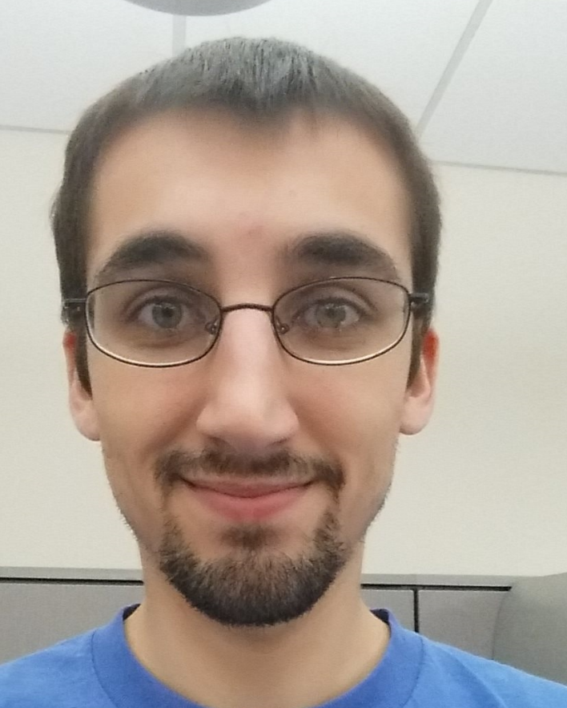
Scott Schroeder
Degree: Master of Accountancy
Major: Accounting, Tax
Worked in: Tax Compliance, Accounting
After graduation I will be taking my CPA exams over summer and then will start at Baker Tilly in their Madison office in fall as a tax accountant. My experience at Business Services has taught me navigation of databases, excel analysis, and tax reporting both for domestic and international people. The thing I enjoyed most about working here has been that it never felt like I was working in a hierarchy. Everyone is so friendly and willing to help out no matter what position they hold. I hope the work environment at Baker Tilly is just as warm and welcoming as Business Services has been for me!

Slide 6
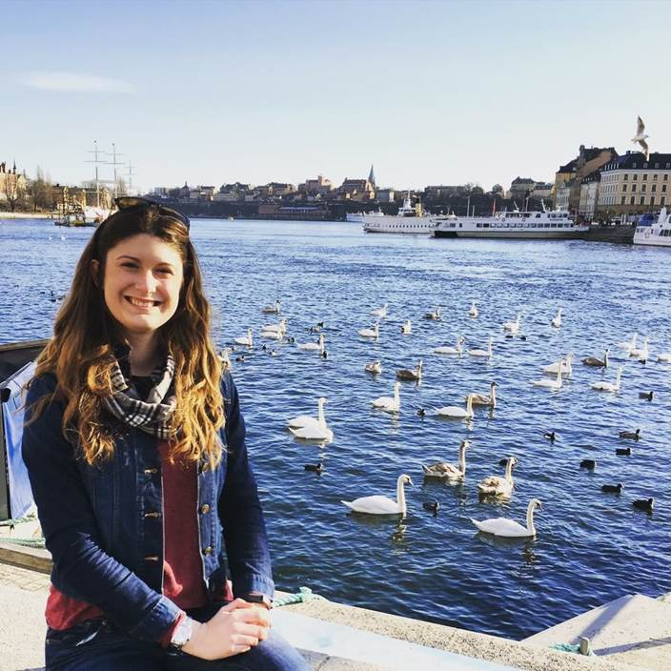
Jamie Truitt
Degree: Bachelor of Business Administration
Major: Finance and Risk Management and Insurance
Worked in: Asset Management, Accounting
I will be moving to Denver where is will be a Finance & Risk Control Analyst at Ardent Mills. I am very excited to move out west, I love the mountains & the weather! Here at Accounting Services I enjoyed the people I worked with most. When I first started as a sophomore this was my first business related job, so it was interesting seeing how accounting and business services departments actually work in comparison to what I learned in class.

Slide 7
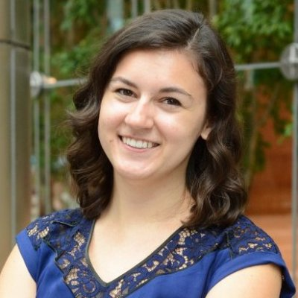
Jenna Wasieleski
Degree: Bachelor of Business Administration
Major: Actuarial Science
Worked in: Accounts Payable, Accounting
This August, I will be moving to Chicago, IL to join Deloitte Consulting as a Human Capital Business Analyst in the Actuarial, Rewards & Analytics group. My work over the past 3 years in the Accounts Payables area of Accounting Services has prepared me in many ways for my future job. I learned how important it is to ask questions and became more confident in doing so (because even after 3 years new situations pop up quite often.) I’ve also really improved my attention to detail, and because of WiGrow I feel like I had an advantage in interviews and in resume building. After 3 years it’s going to be strange to leave, and I’m going to miss seeing everyone every day.

