Slide 1
COVID-19 Related Leave
April 24, 2020

Slide 2
Leave Provisions
UW COVID-19 Pandemic Employee Work Location and Leave Policy (COVID-19 Leave) Issued March 17/Revised April 1, 2020
Paid leave provided through May 1, 2020 for eligible UW-Madison employees
Families First Coronavirus Response Act (FFCRA) provisions Effective April 1 through December 31, 2020
Emergency Paid Sick Leave Act (EPSLA)
Up to 80 hours of Paid Sick Leave for the coronavirus emergency for six specific reasons
Emergency Family & Medical Leave Expansion Act (EFMLEA)
Adds one additional covered reason for FMLA: Up to 12 weeks of leave to care for the employee’s son or daughter, who is under 18, if the child’s school or place of care the child attends has been closed, or the childcare provider is unavailable

Slide 3
Month of March
March 17 – March 31
UW COVID-19 Pandemic Employee Work Location and Leave Policy (UW-COVID-19 Leave) Issued March 17/Revised April 1, 2020
Originally, was up to 80 hours and then it was revised later.
Report using Timesheet (myUW portal)
COVID-19 leave taken prior to April 1, doesn’t count toward an employee’s entitlement under FFCRA.

Slide 4
Month of April
UW COVID-19 Pandemic Employee Work Location and Leave Policy (COVID-19 Leave) Issued March 17/Revised April 1, 2020
Expanded from 80 hours to Unlimited Hours
Use timesheet to report
AND
Families First Coronavirus Response Act (FFCRA) provisions Effective April 1 through December 31, 2020
Use FFCRA Form to Report

Slide 5
Month of April
Report leave under both the UW-Madison COVID-19 provisions AND FFCRA
Use the Timesheet AND the FFCRA Form
Submit the FFCRA Form to Austin.Tamayo@wisc.edu
Austin will follow up with any documentation that may be needed
Not all leave taken under UW-Madison COVID-19 provisions will need documentation

Slide 6
Month of April (additional details)
1. COVID-19 Leave and leave under the FFCRA (EPSLA& EFMLEA) will run concurrently during this period:
  Employees will receive 80 hours (prorated based on FTE) of Covid-19 hours in the month of April, that will also count towards emergency leave under the FFCRA.
2. Leave during this period for a reason covered under FFCRA (EPSLA/ EFMLEA) will be
designated as FFCRA leave & will meet the university’s obligation (and sometimes exceed)
under FFCRA.
  Employees will receive 80 hours (prorated based on FTE) of Covid-19 hours in the month of April, that will also count towards emergency leave under the FFCRA.
3. Leave under EFMLEA will count towards an employee’s 12 work week entitlement under FMLA.
4. COVID-19 leave will pay the employees’ regular rate during this period.
5. COVID-19 leave & FFCRA leave needs to be tracked and recorded and supported with
information/documentation provided by the employee.
  Employees will need to submit an Emergency Leave Request Form (FFCRA Request Form).
  Anyone who took Covid-19 leave will need to submit the Emergency Leave Request Form.

Slide 7
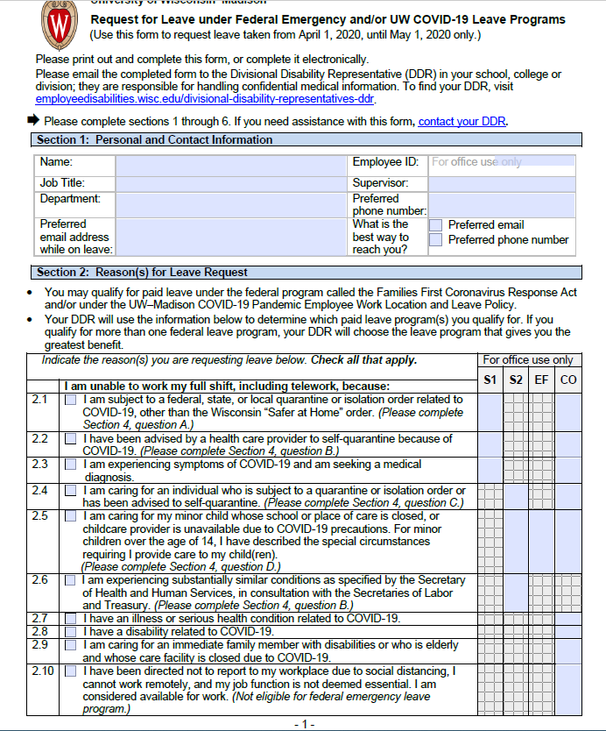
Emergency Leave Request Form

Slide 8
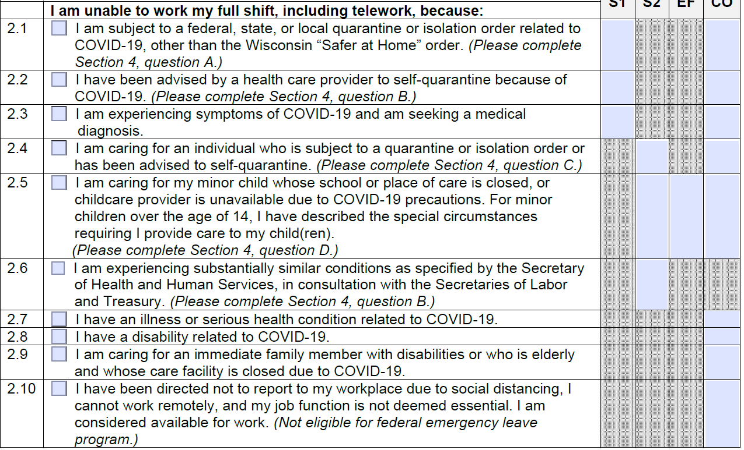
Reasons

Slide 9
Month of May and Beyond
After May 1, 2020, UW-Madison COVID-19 leave will no longer be available, if the UW COVID-19 Leave Policy is not extended.
The FFCRA leave options will remain until December 31, 2020
Provide paid leave for an FFCRA reason for eligible employees
  for the time periods required under the FFCRA,
  if an employee hasn’t yet exhausted their leave entitlement under the FFCRA.
Eligible employees can choose to use their own accrued paid leave to get up to their full salary (if not receiving their full pay).

Slide 10
Documentation
“Request for Leave under FFCRA Form”: Required for all requests
Require medical documentation (email, photo of MyChart, note, etc.) from the health care provider when the leave request is for self-quarantine/isolation for the employee and when the employee is caring for an individual when the individual has been advised to self-quarantine.
Does not require employee to go in to see their HCP
  In cases where the employee is sick, this leave may also be designated as FMLA/WFMLA if the employee qualifies.
  In cases where the individual is sick, this leave may also be designated as FMLA/WFMLA if the individual is also a qualifying family member under the FMLA/WFMLA.
Do not require official closure documentation from employee when caring for child(ren) when school, childcare, place of care closed.

Slide 11
FFCRA PROVISIONS
Two Categories:
  EPSLA (Emergency Paid Sick Leave)
  EFMLEA (Emergency Family & Medical Leave Expansion)

Slide 12
Effective Date & Eligibility
Begins: April 1, 2020
EPSLA | EFMLEA
Effective Dates: Begins: April 1, 2020 Ends: December 31, 2020
Eligibility Eligible on Day 1 of employment Immediately eligible regardless of how long employed | Eligibility Eligible once employee on the payroll 30 calendar days immediately prior to the day leave would begin

Slide 13
Reasons for EPSL & PAY
Category 1 Reasons #’s 1, 2, & 3 (“Employee focused”) | Pay
Employee is subject to a governmental quarantine or isolation order due to COVID-19 | Paid employee’s regular rate Max of $511/day Prorated for part-time Maximum: $5,110 in total over the entire EPSLA period Employees able to use accrued leave per paid leave policies to supplement the amount of EPSLA up to normal earnings if earn more than $511/day
2. Employee has been advised by a health care provider to self-quarantine due to COVID-19 related concerns
3. Employee is experiencing COVID-19 symptoms and is seeking a medical diagnosis

Slide 14
Reasons for EPSLA & PAY
Category 2 Reasons #’s 4, 5, & 6 (“Other focused”) | Pay
4. The employee is caring for an individual who is subject to a quarantine or isolation order or has been advised to self-quarantine | Paid 2/3 of employee’s regular rate Max $200 per day Can use accrued leave per paid leave policies to supplement the amount of EPSLA up to normal earnings Maximum: $2000 in total over the entire two-week period
5. The employee is caring for a son or daughter if the school the child attends is closed or daycare is unavailable due to COVID-19 precautions
6. The employee is experiencing any other substantially similar condition specified by the Secretary of Health and Human Services and the Secretary of Labor.

Slide 15
Reasons for EFMLEA & Pay
FMLA expanded to permit an employee, who is unable to work or telework due to a need for leave
One additional reason employees can take up to 12 weeks of FMLA (It is not an additional 12 weeks of FMLA)
Reason | Pay
To care for the employee’s son or daughter, who is under 18, if the school the child attends is closed or if daycare is unavailable. | First 10 days: Unpaid May use EPSLA or accrued leave per paid leave policies up to normal earnings Prorated for part-time Remaining time (up to 10 weeks): Paid 2/3 of employee’s regular rate Max $200 per day Max $10,000 Prorated for part-time May use accrued leave per paid leave policies to supplement up to normal earnings
If applying EPLSA for the first 10 unpaid days the Max is $12,000 in the aggregate per employee

